Slide 1
PWN basics
Briefing of gdb and pwntools with an example
邱韜 @ April.13, 2020

Slide 2
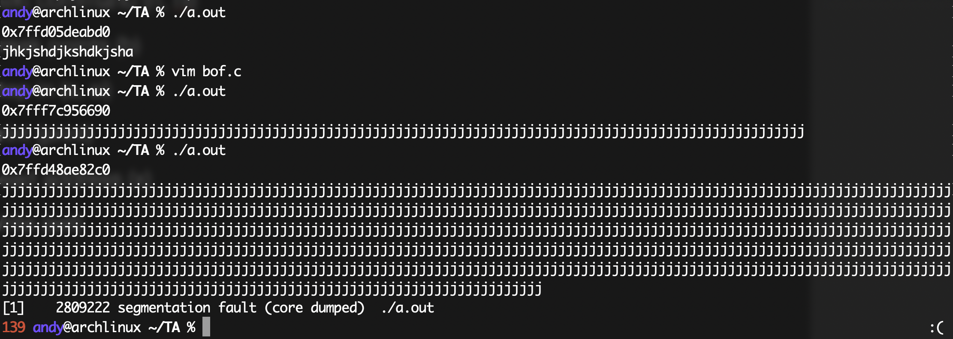
First glimpse
When we get a binary file

Slide 3
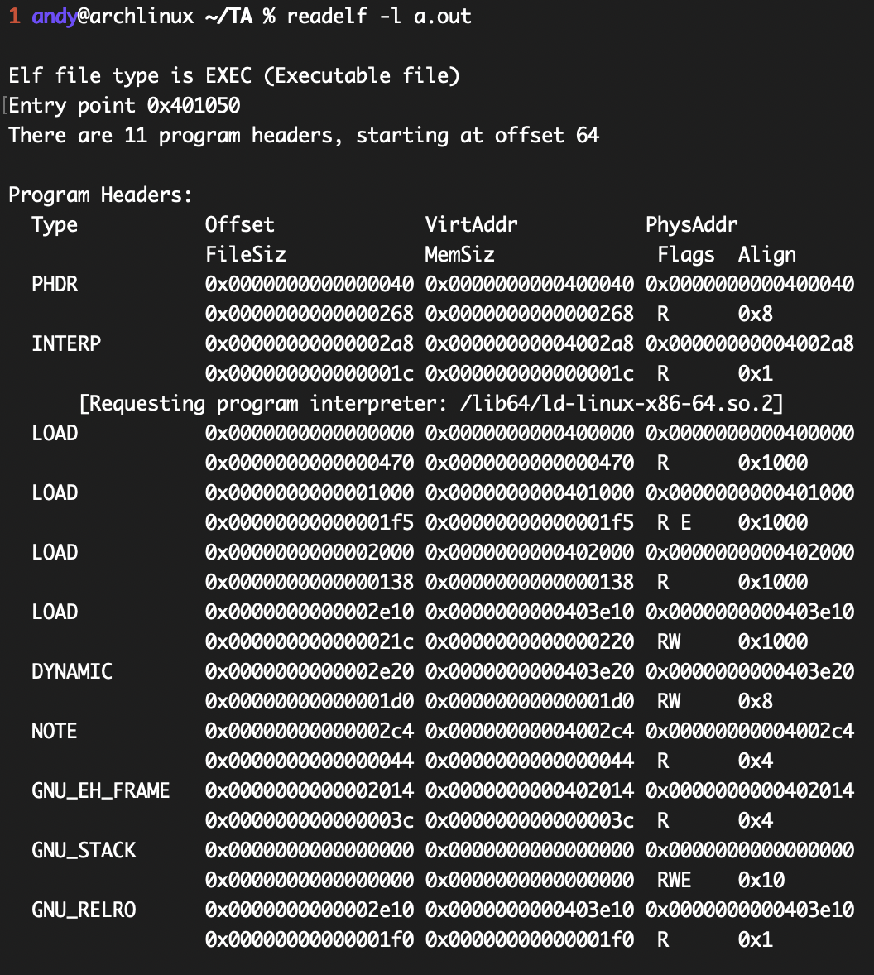
First glimpse
When we get a binary file

Slide 4
GDB
Useful commands
Start
Next command (n, ni)
Break points (b)
Step in (s, si)
Print (print)
Read address (x)
Write (set)
Memory layout (vmmap)

Slide 5
“x” command
Address expression: x(/[Number][i,s,b,w,g,d])
“ｓ”: address of string
“ｉ”: address of instruction
“ｂ”: address of byte

Slide 6
GDB—Peda
Python Exploit Development Assistance for GDB
https://github.com/longld/peda
checksec

Slide 7
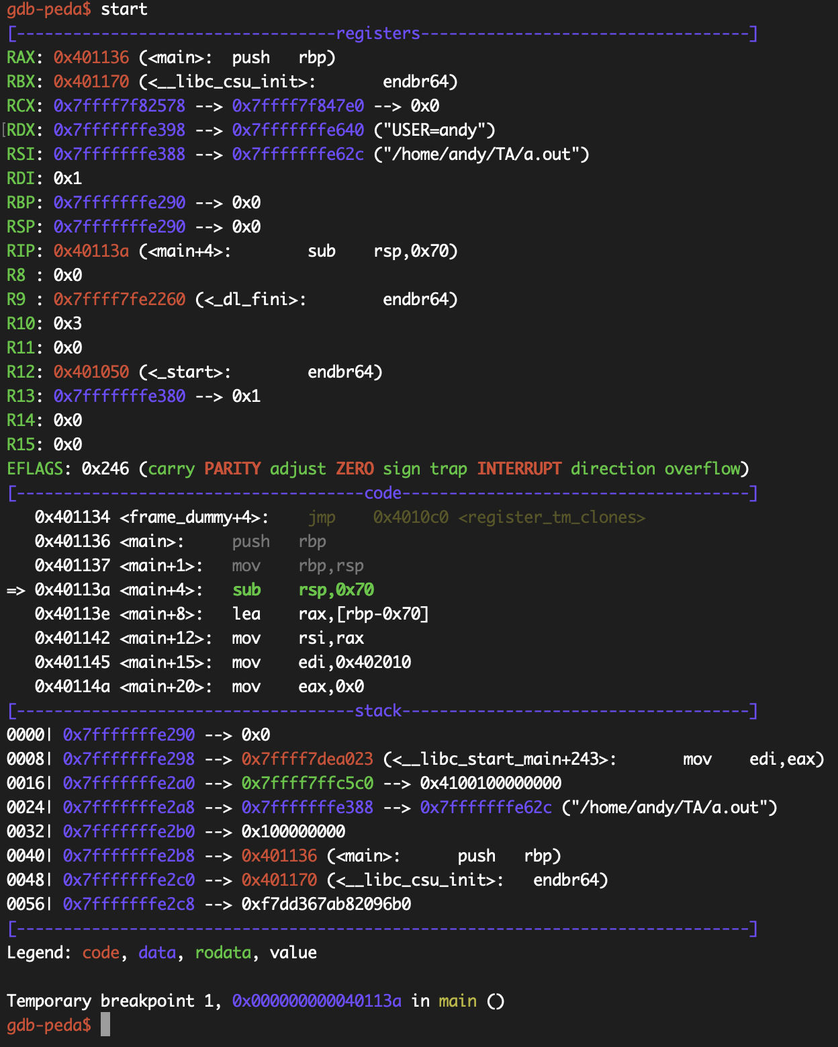

Slide 8
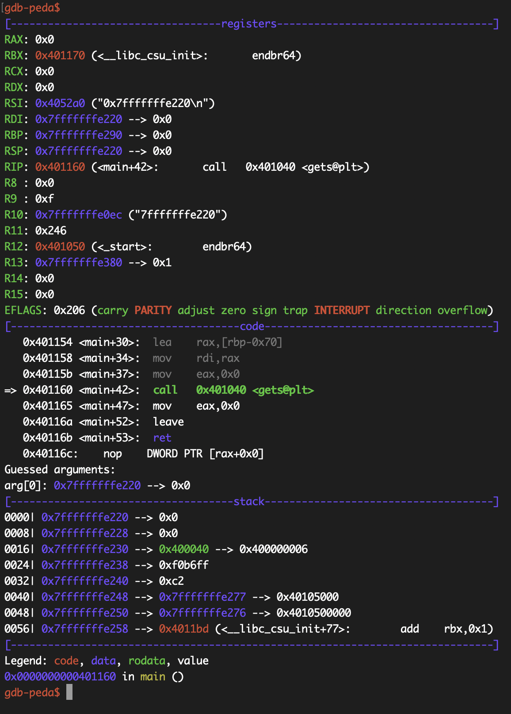

Slide 9
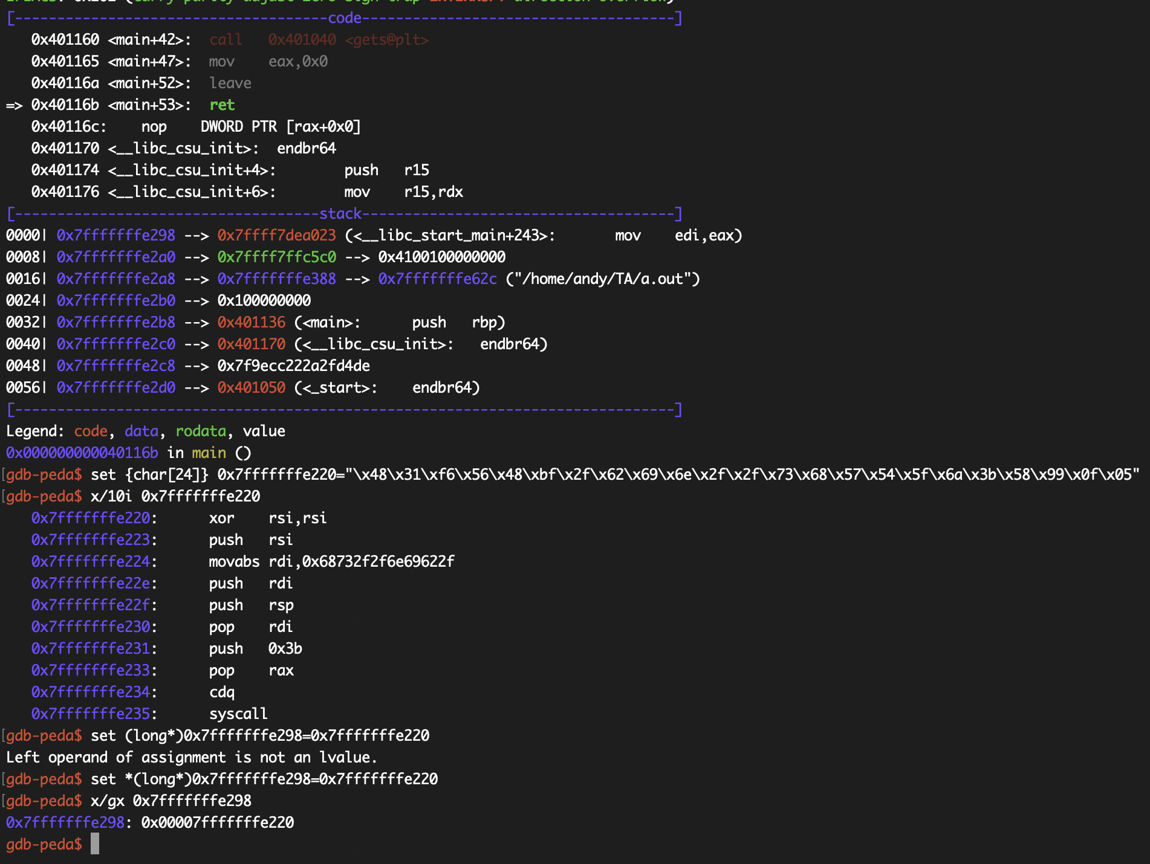
Return Address
Shellcode
Modifying Return Address

Slide 10
Disassembly
objdump
Use “disassemble” in gdb
Or “objdump -d”

Slide 11
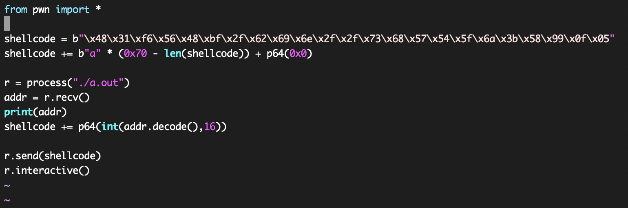
PWN tools
CTF framework and exploit development library

